Slide 1
PAY2GROW
AI THAT KNOWS WHAT YOU CAN SAFELY AFFORD
₹60,000 purchase?
KNOW WHAT YOU CAN AFFORD BEFORE YOU SPEND OR INVEST.
An AI-powered financial intelligence platform that understands your cash flow, goals and obligations to help you make smarter everyday money decisions. It is a decision layer rather than another payment app.
Balance says: ₹20,751
True affordability
− ₹43,748
Purchase would trigger high-cost credit and delay the emergency-fund goal.
WAIT / SAVE FIRST
FINTECH + AI + PERSONAL FINANCE

Slide 2
Problem: We can pay instantly, but can't see the future
24,162 Cr
66 Cr/day
45.5%
₹31K–32K Cr
UPI transactions in FY 2025–26
Approx. daily UPI transactions
Household debt / GDP (June 2026)
Monthly SIP contribution run-rate
Today’s user faces:
Income
↓
Expenses + EMIs + Debt + Goals
↓
Current Balance
↓
❌ Balance ≠ Affordability
Easy digital payments → easier impulse spending
Financial information scattered across multiple platforms
Existing budgeting tools are mostly backward-looking
Users judge affordability using current bank balance
Difficulty deciding how much to save vs spend vs invest
Financial goals often get disrupted by unexpected purchases
Research basis: Pay2Grow Deep Research Strategy • NPCI / RBI / AMFI / Ministry of Finance
Prototype / simulated data

Slide 3
Why This Problem Matters Now in current Situation.
India's financial stack has matured.
What this enables
24,162 Cr+ transactions in FY 2025-26
Everyday payments generate rich financial behavior data
UPI
Consent-based financial context
Consolidated balances, recurring obligations, debt and goals can feed one decision engine.
Forward and confident looking decisions
Move from “you spent ₹X” to “this purchase changes your next 90 days.”
Explainable AI
Use deterministic math for money; use an LLM only to explain the result. User still lacks real-time guidance on Save vs Spend vs Invest
“INDIA HAS THE FINANCIAL RAILS BUT PAY2GROW ADDS THE INTELLIGENCE.”
2.1B+ Accounts enabled on Account Aggregator ecosystem .Consent-based financial data can feed a unified financial view.
AA
9.6 Cr+ active SIP accounts Systematic investing is becoming part of everyday financial planning.
SIP
AI for Financial Intelligence Complex financial data can be converted into simple, actionable insights for better decision-making.
AI

Slide 4
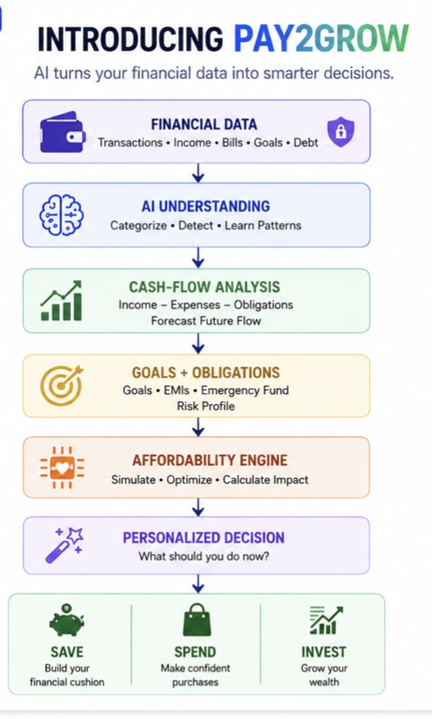
Solution: Introducing Pay2Grow
Pay2Grow converts financial data into actionable
decisions
OUR CORE USP
“Don’t just track where your money went. But actually understand where today’s decision takes you”
Pay2Grow • Hackathon Concept
Prototype / simulated data

Slide 5
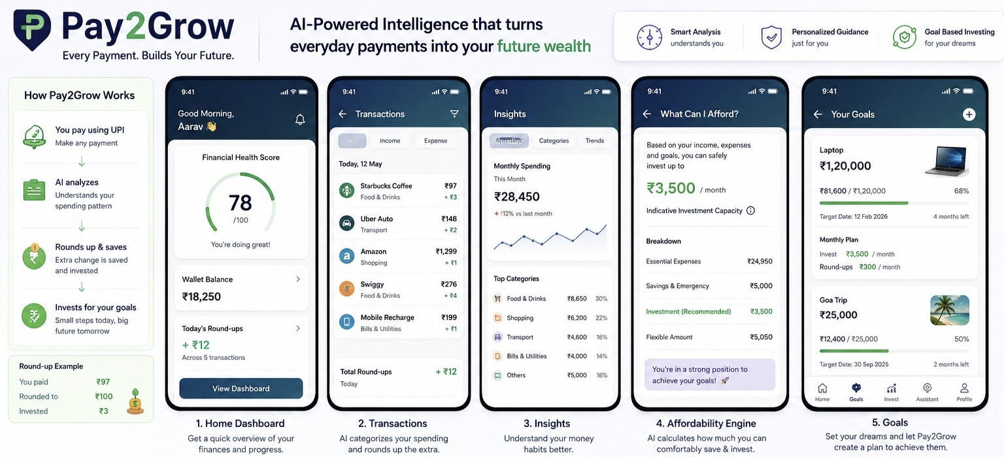
01 — UnderstandConnect financial data through consent-based sources or use simulated data.0uu2 — AnalyzeAI categorizes transactions and identifies:IncomeFixed expensesVariable expensesDebtRecurring paymentsSavings behaviour03 — PredictForecast upcoming cash flow and financial obligations.04 — SimulateCalculate the impact of a potential purchase or investment.05 — DecideRecommend:BUY / WAIT / SAVE / INVEST06 — LearnContinuously update the financial profile based on new behaviour.
What the user sees
UI concept • generated visual • simulated financial data
Prototype / simulated data

Slide 6
Most Important feature: “Can I Afford This?”
USER INPUT
DECISION ENGINE
OUTPUT
I want to buy
✓
Upcoming rent / EMIs
Not affordable
₹60,000
✓
Emergency liquidity floor
True affordability capacity
for a phone
− ₹43,748
✓
Existing SIP / goal commitments
Current balance
Goal impact
₹20,751
✓
Outstanding high-cost debt
Emergency fund delayed by ~8.5 months
✓
30–90 day cash-flow forecast
“Balance ≠ affordability”
RECOMMEND: SAVE FIRST

Slide 7
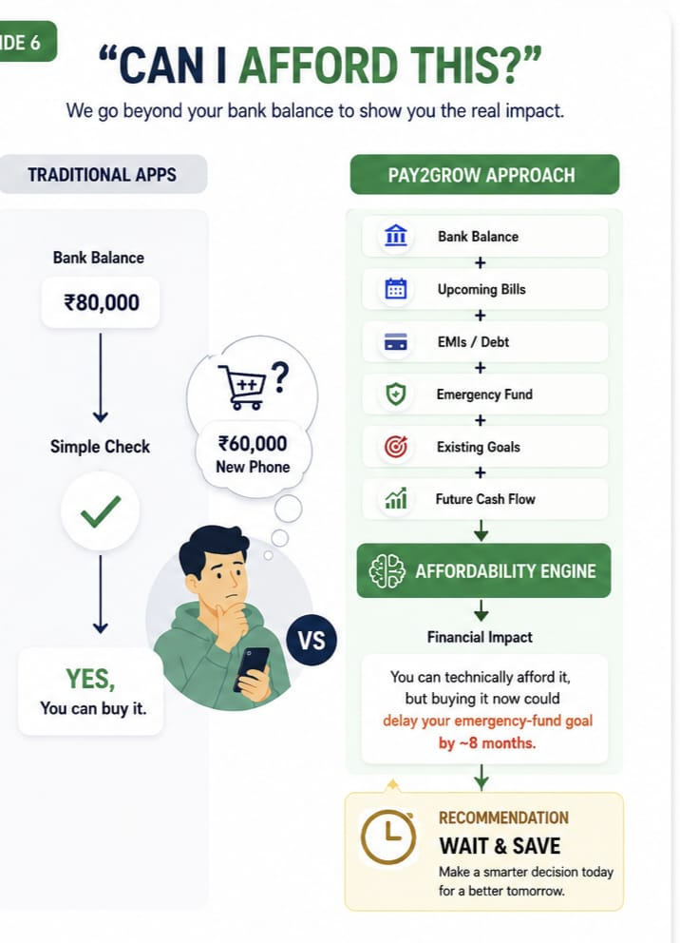
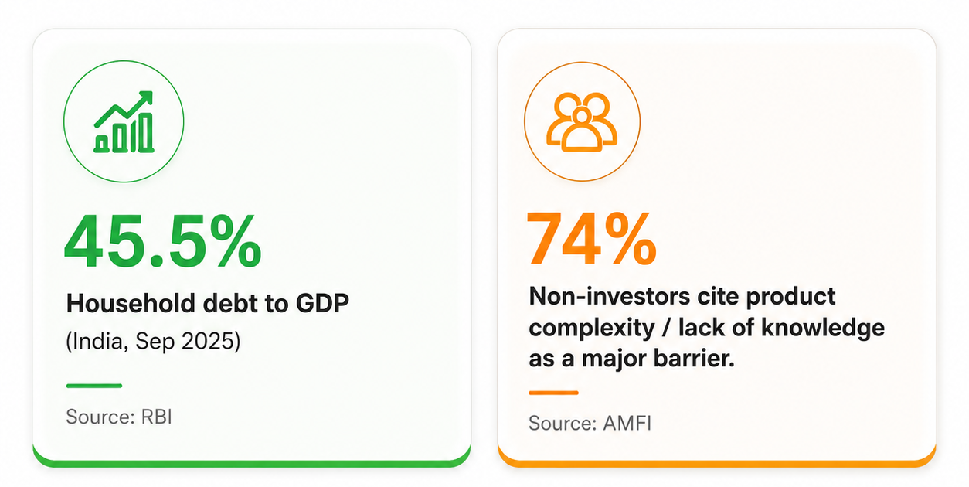
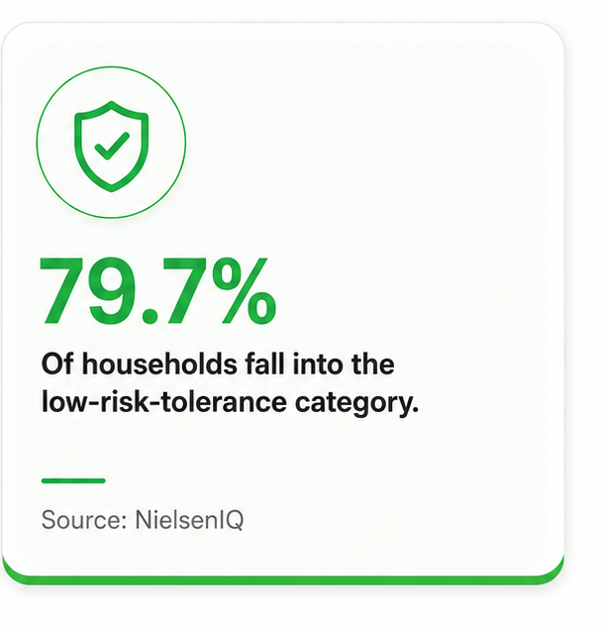
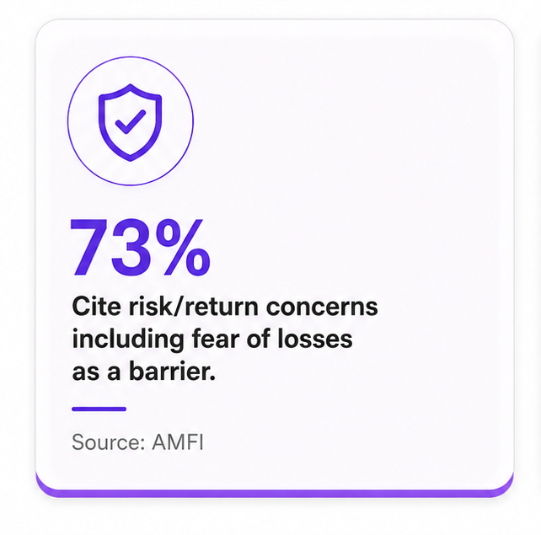
Can I Afford This? …….Your Bank Balance Doesn't Tell the Full Story.
The Bigger Picture
Example box: User wants a ₹60,000 phone Current balance: ₹80,000 Looks affordable: -But Pay2Grow checks: Upcoming EMI Rent & bills Emergency-fund target Existing SIP Expected month-end cash flow Result:- “You can technically afford it — but buying it now could delay your emergency-fund goal.” Recommendation: WAIT & SAVE

Slide 8
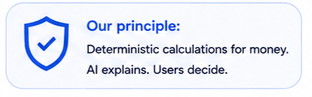
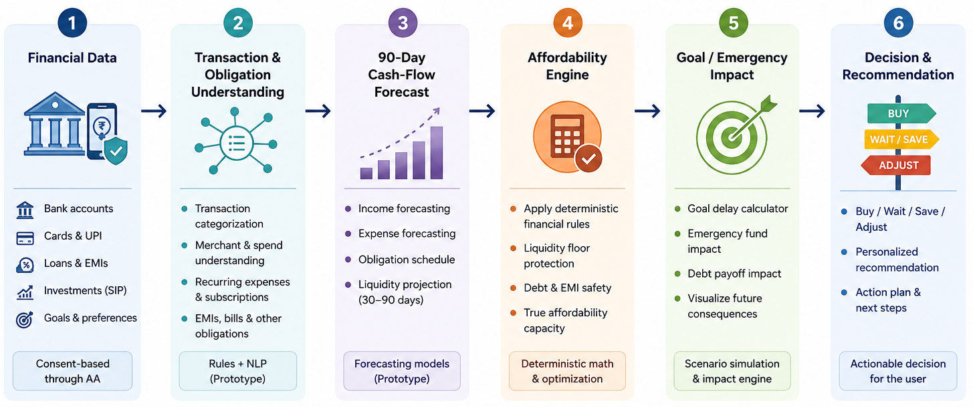
Technical architecture
Deterministic money, conversational AI
AI helps understand your data and explain results. Our engine calculates the money

Slide 9
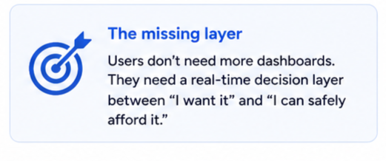
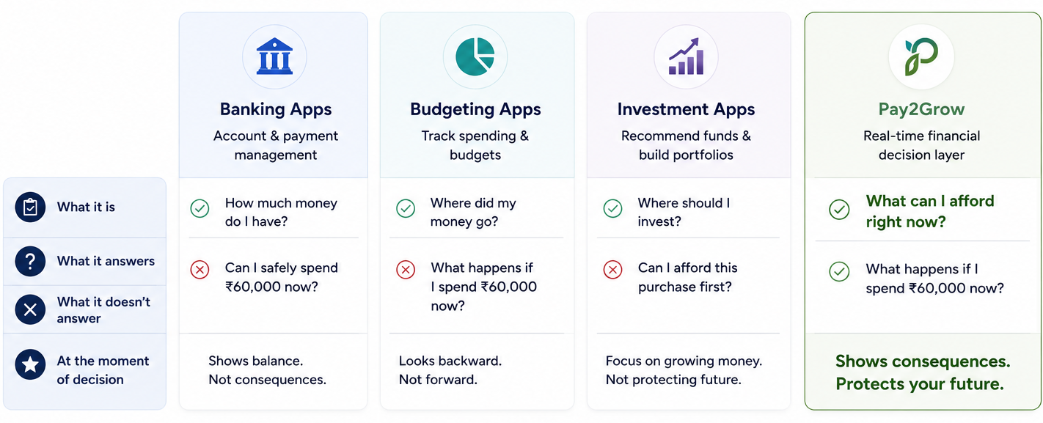
Why this is different
Existing finance apps miss the moment that matters
Most apps lock backward or focus on investments. No one answers: “Can I afford this right now without hurting my future?”
Pay2Grow sits between “I want it” and “ I can safely afford it.”

Slide 10
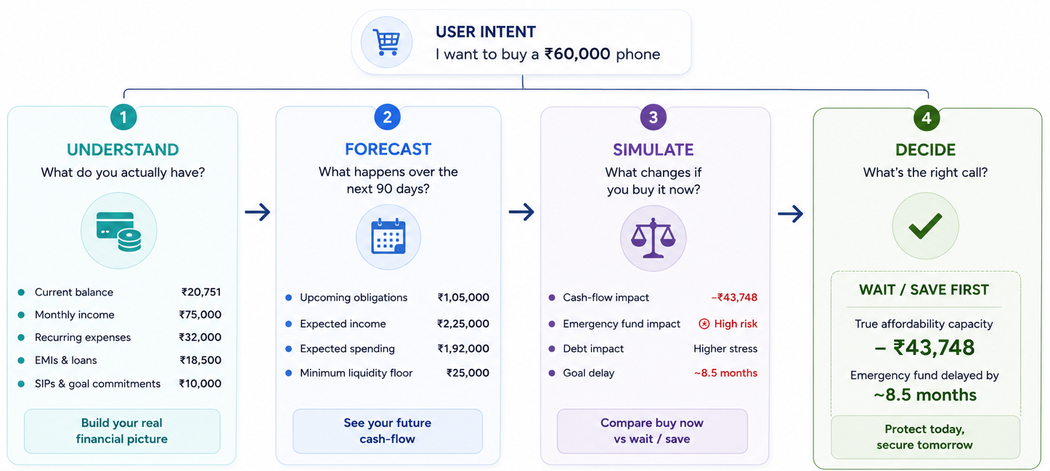
How Pay2Grow Makes A Decision
From intent to impact – our 4-step decision engine.
We don’t just check your balance. We calculate the real impact of your choice on your future
⭐
Pay2Grow doesn’t ask “Can you pay?”
It asks “Can you safely afford the consequences?”

Slide 11
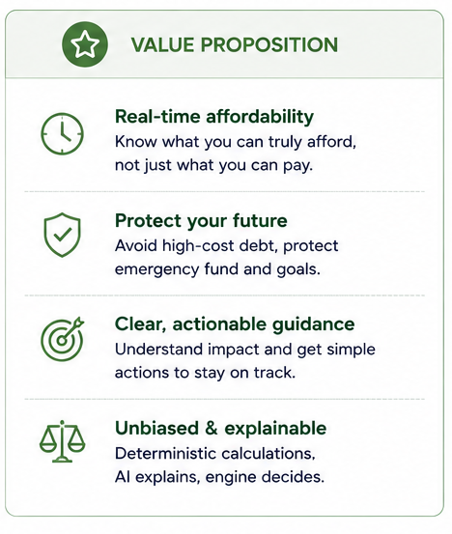
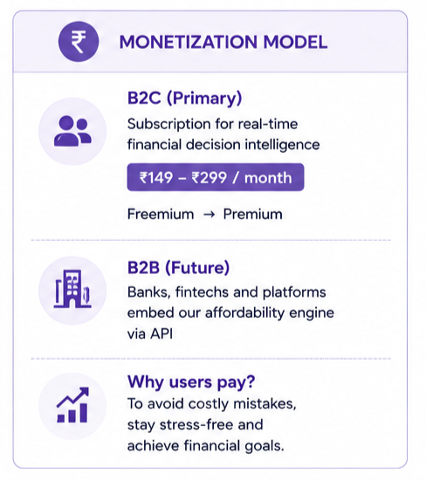
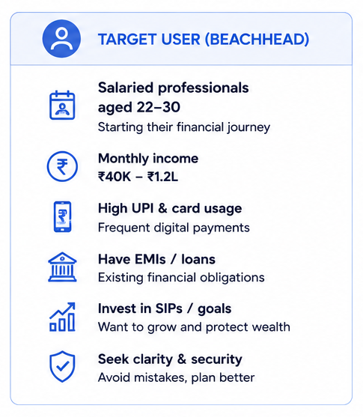
Who pays?
Our first users. Our initial revenue
We start with a clearly defined user segment that feels the pain today and is ready to pay for clarity and confidence.

Slide 12
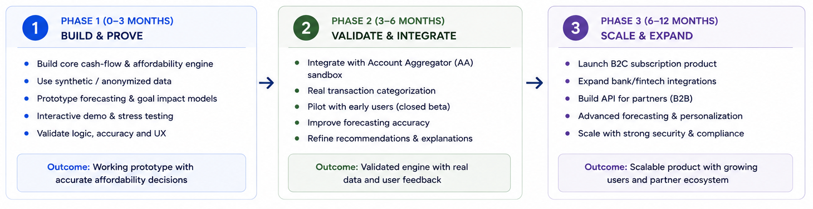
Execution roadmap
A clear path to build, validate and scale.
We will process in three focused phases to deliver a reliable and impactful financial decision engine.

Slide 13
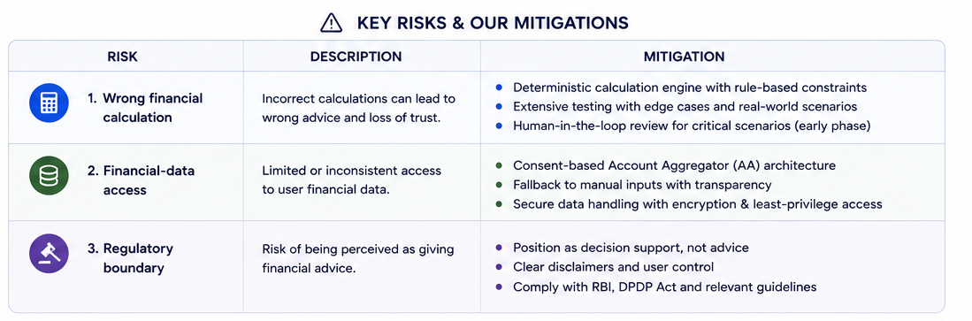
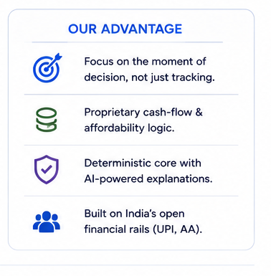
Kill Risks & Our Mitigation
We Identify risks early.
We mitigate them by design.

Slide 14
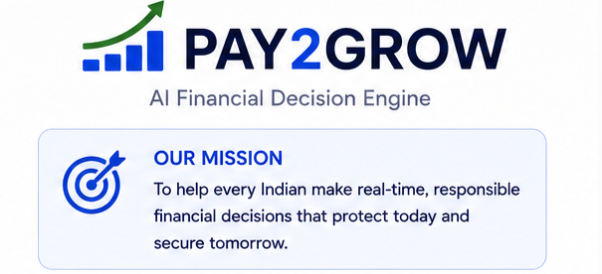
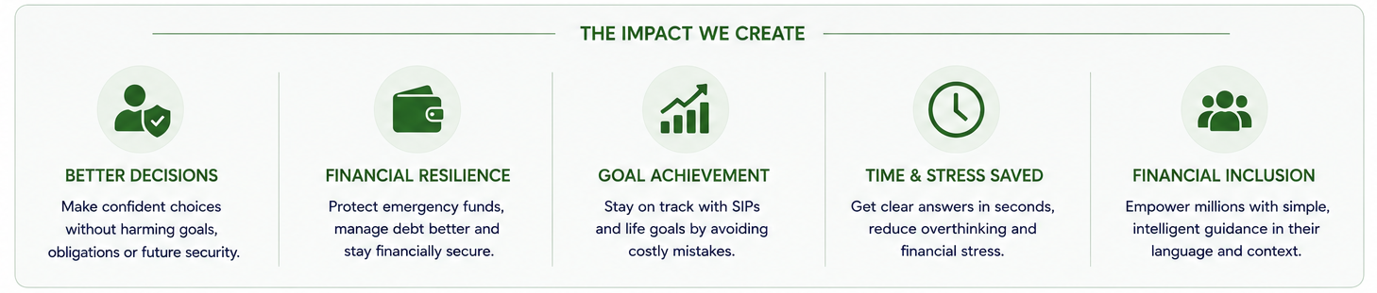
The Future We are Building
Financial clarity in every decision.
A strong tomorrow for everyone.
Pay2Grow empowers people to make confident financial decision in the moment – without regret later.
💙Thank You
Don’t just Pay. know the impact
Notes:
Don’t just pay know the impact

